Slide 1
C206 L11 Part A
Sprint Execution III – Code Refactoring

Slide 2
The Scrum Framework
Processes of Scrum Framework
Product Backlog Grooming
Sprint Planning
Sprint Execution
Test-Driven Development (TDD)
Daily Scrum
Code Refactoring
Code Review
Sprint Review
Sprint Retrospective
Lesson 9
Lesson 10
Lesson 10 and 11
Lesson 11 Part A
Lesson 11 Part B
Lesson 12 Part A
Lesson 12 Part B

Slide 3
C206 L11 Part A Learning objectives
Sprint Execution
Daily Scrum / Stand-up meeting
Code Refactoring

Slide 4

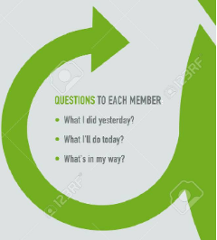
Daily Scrum/Stand-up meeting (10 min)
Assume now is the third day of the sprint.
Perform daily stand-up meeting
Update Sprint Backlog and Burndown Chart
3 questions to each member
What did you do yesterday?
What will you do today?
Are there any impediments in your way?

Slide 5
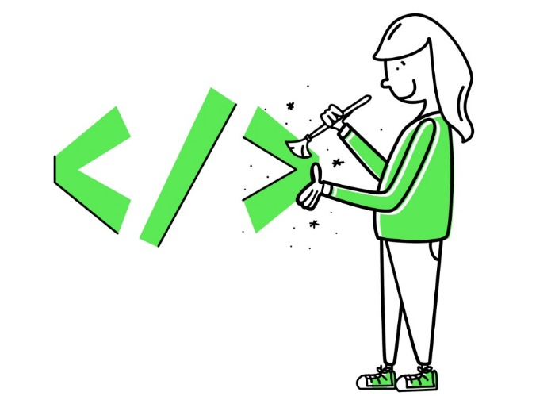
Code Refactoring

Slide 6
Code Refactoring
What is Code Refactoring?
The process of restructuring existing code.
Improves readability and maintainability.
Does not alter the external behavior of the code.
Benefits of Code Refactoring
Easier to understand.
Reduces complexity.
Makes code easier to modify and extend.
Helps find and fix bugs.

Slide 7
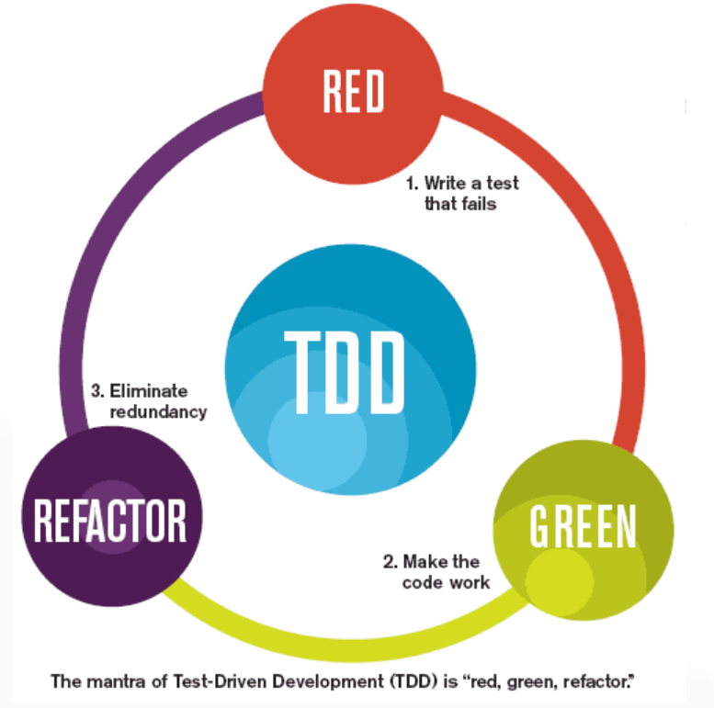
Code Refactoring
When to Refactor Code?
After fixing bugs (‘Green’) or before adding new features (‘Red’).
During code reviews (Lesson 11b).
Whenever code smells are detected.

Slide 8
Code Smells
Code Smell | Description | Refactoring Solution
Magic Numbers | Hard-coded numeric values that appear directly in the code without explanation. | Extract Constant: Move the hard-coded numbers into named constants.
Long Method | Methods that are too long and do too much, making them hard to understand and maintain. | Extract Method: Break down the method into smaller, more focused methods.
Duplicate Code | Identical or very similar code appearing in multiple places. | Extract Method/Class: Move the duplicate code into a single method or class and reuse it.
Data Clumps | Groups of data that are always used together, appearing in multiple places. | Extract Class: Combine the data clumps into a new class.
Feature Envy | Methods that seem more interested in the data of another class than that of their own. | Move Method/Extract Method: Move the method to the class it is more interested in, or extract parts of it.

Slide 9
Code Smells and more…..
Code Smell | Description | Refactoring Solution
Large Class | Classes that have too many responsibilities and too much code. | Extract Class: Split the class into smaller classes, each with a single responsibility.
Lazy Class | Classes that are not doing enough to justify their existence. | Inline Class: Move the features of the lazy class into another class and delete the lazy class.
Switch Statements | Large switch statements or chains of if-else statements that are difficult to maintain. | Replace Conditional with Polymorphism: Use polymorphism to handle different cases.
Message Chains | A series of calls through multiple objects, creating long lines of code that are hard to understand. | Hide Delegate: Create a method in one of the middle classes to hide the delegate.
Primitive Obsession | Using primitive data types instead of small objects for simple tasks (e.g., using strings for currency). | Replace Data Value with Object: Introduce a new class for the primitive data type.

Slide 10
Perform Code Refactoring
Notes:
https://docs.pytest.org/en/8.0.x/getting-started.html

Slide 11
Hands on activity – Code Refactoring (90 min)
Perform code refactoring on the Scrum Master’s share repository of the ResourceCentre project.
Allocate all the refactoring tasks to your team members.
Create a Github branch before you start changing the codes.
Run pytest regularly to ensure no error in your change.
Merge your branch back to the main branch after you completed your refactoring.
Watch the video in the student Resources folder on how to refactor the codes.
Derive the test cases from the pytest codes for the newly created methods.

Slide 12
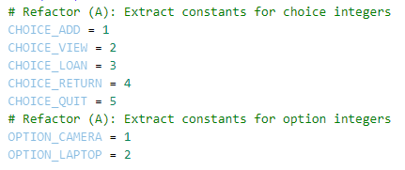



Refactor (A) – Extract Constants
Create the constants
Replace integer values with constants
Magic Number
What does the integer value ‘1’ represents?

Slide 13
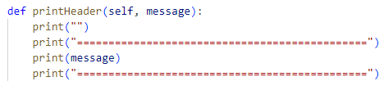

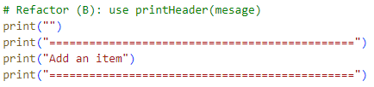



Refactor (B) – Extract Method
Extract into a method
Use the newly created method
Duplicate codes
Although the headers are different, but it can be passed into the method via argument.

Slide 14
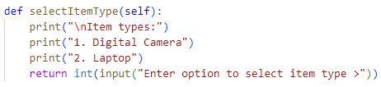
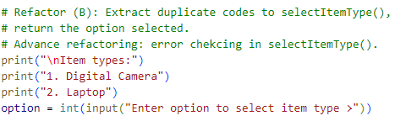

Refactor (B) – Extract Method
Extract into a method
Use the newly created method
Duplicate Codes
This set of codes appears in several locations.

Slide 15
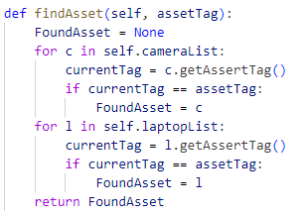
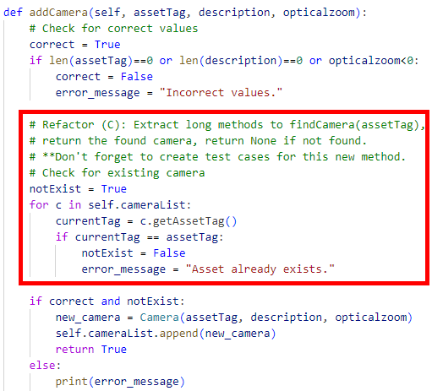
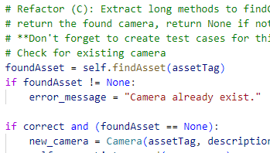
Refactor (C) – Extract Long Method
Extract into a method
Use the newly created method
In addCamera()
and addLaptop()
Long Methods
This set of codes has its specific purpose (find an asset), and it is making the addCamera() method ‘long’…

Slide 16
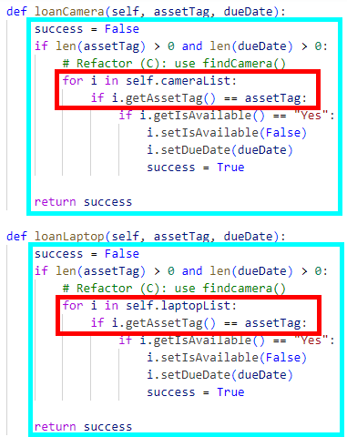
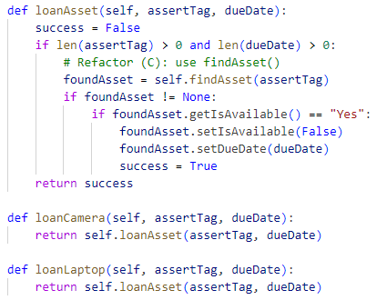
Refactor (C) – Use newly created method + Extract Duplicate Codes
Duplicate Codes
These two sets of codes are very similar.
Merge the duplicate codes of loanCamera() and loanLaptop() into one method loanAsset().
Long Methods
This set of codes search for the asset.

Slide 17
Test Cases for findAsset(assetTag)
The function findAsset(assetTag) search the inventory and return the asset tag number if found. The function will return None if not found.
No. | Unit Test Case | Expected Result
1
2
3
4

Slide 18
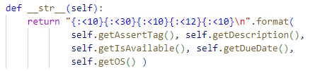
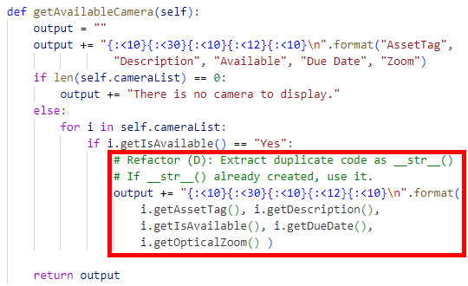
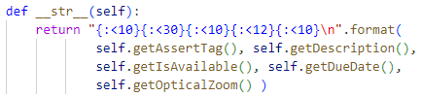

Refactor (D) – Extract Method
Extract into a method in camera.py and laptop.py
laptop.py
camera.py
Use the newly created method
Feature Envy
This set of codes is heavily using the methods of Camera and Laptop classes.
Duplicate Codes
This set of codes also appear in several locations.

Slide 19
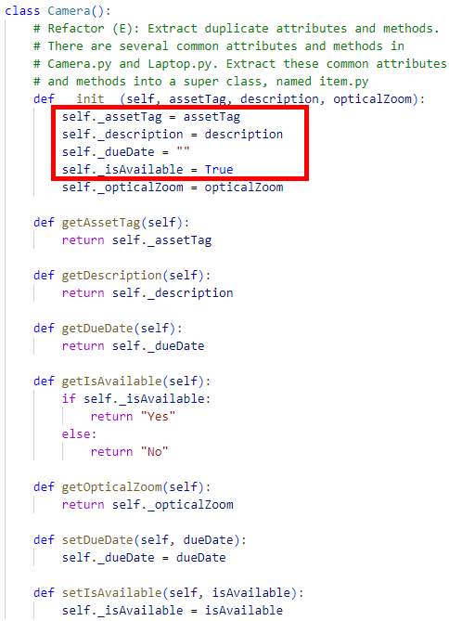
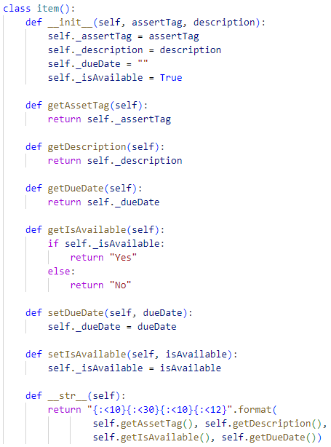
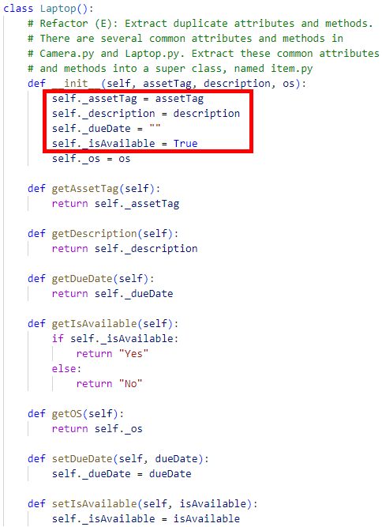
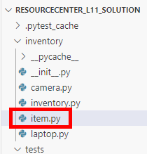
Refactor (E) – Extract Super Class
Data Clumps
Similar data appearing in multiple locations.
Merge common attributes and methods into a super class.

Slide 20
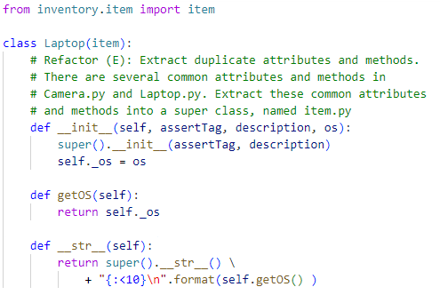
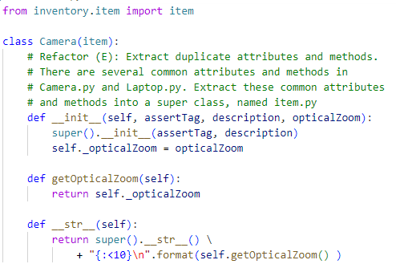
Refactor (E) – Using the super class
laptop.py
camera.py

Slide 21
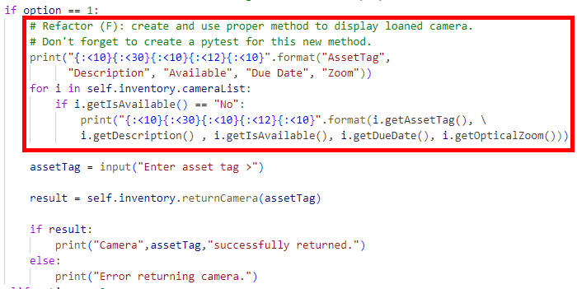
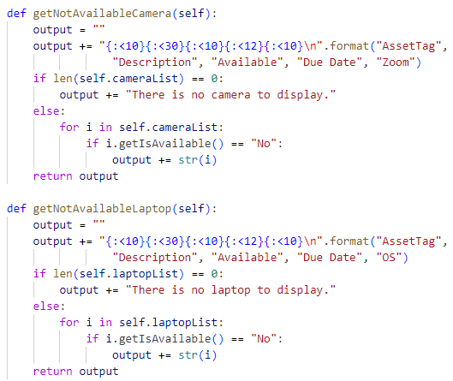


Refactor (F) – Extract Long Method
Extract into methods
Long Methods
This set of codes has its specific purpose (displaying of not available assets) and it is making the codes ‘long’…
Use the newly created methods
inventory.py
resourcecentre.py

Slide 22
Test Cases for getNotAvailableCamera() and getNotAvailableLaptop()
The function getNotAvailableCemara() and getNotAvailableLaptop() return a string of cameras and laptops that are on loaned.
No. | Unit Test Case | Expected Result
1
2
3

Slide 23
Summary
Scrum/stand up meeting for Day 3
Code Refactoring
Team collaboration and development via GitHub

